Slide 1
VBA in BFC3540

Slide 2
What is VBA?
VBA stands for Visual Basic for Applications. It is the programming language for Excel, Word, etc.
Learning VBA is extremely useful for Spread Sheet tasks that require a lot of data or laborious repetition. It is very widely used in corporate.

Slide 3
Introduction to VBA in Excel:
Introduction to VBA in Excel:
Defining names in Excel
Basic programming constructs
VBA Excel specific commands
The VBA debugger
Calculating the covariance matrix in Excel using VBA
The parts of the VBA program:
Average Return
Calculation of Excess Return Matrix
Transpose of Excess Return Matrix
Calculation of Variance Covariance

Slide 4
Week 1 Coverage
Overview
VBA Debugger
Message Boxes in VBA
Output in VBA
Input in VBA
Variables in VBA
Calculations in VBA
Arrays (1d and 2d arrays)

Slide 5
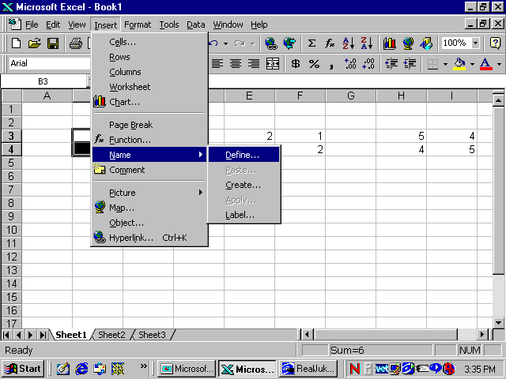
Defining names in Excel
Excel has the ability to call a group of cells a name.

Slide 6
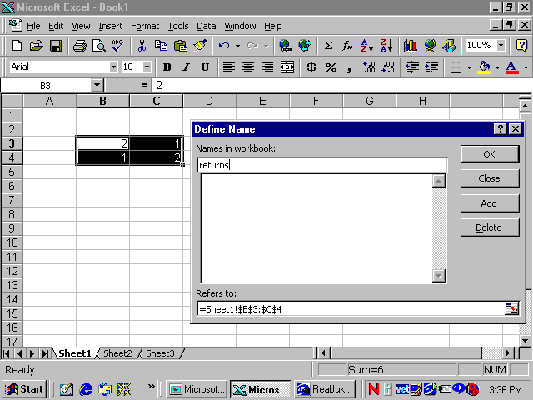
Defining names in Excel cont’d

Slide 7
Basic VBA constructs
This should be revision for most of you.
The readings at the end of the chapter have more details about basic VBA constructs and syntax.
For the code introduced in this section, the basic constructs that must be understood are:
For …. Next Loops
Arrays (e.g. z(row,column))

Slide 8
VBA Excel specific commands
There are a number of VBA commands that are specific to Excel that are required in the VBA code of this section.
These commands count the #rows and columns
noCol = Range("returns").Columns.Count
noRow = Range("returns").Rows.Count
This command finds the average of each the columns of the defined name “returns”
application.Average(Range(“returns”).Columns(i))
This command points to a particular column and row of the defined name “returns”
Range(“returns”).Cells(row,column)

Slide 9
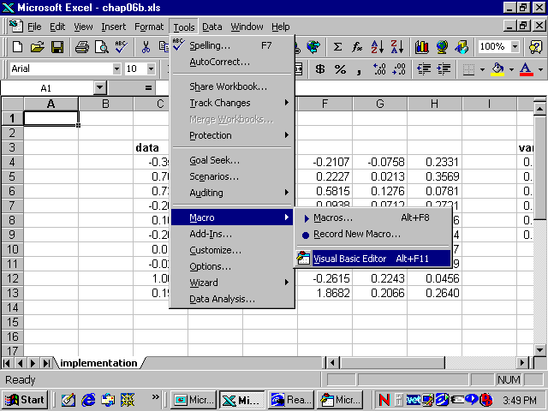
VBA Excel debugger
Tools>Macro>Visual Basic Editor

Slide 10
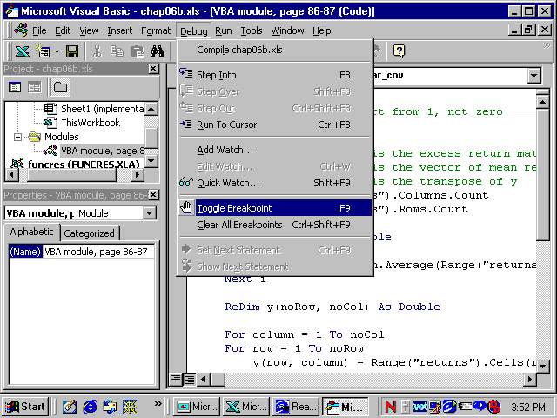
Toggling a breakpoint
A red line appears across the edit window

Slide 11
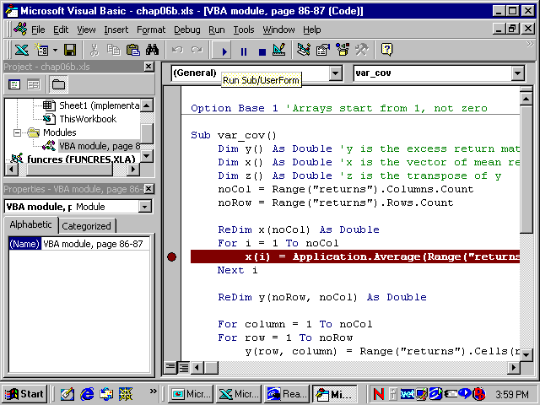
Running a macro from the editor

Slide 12
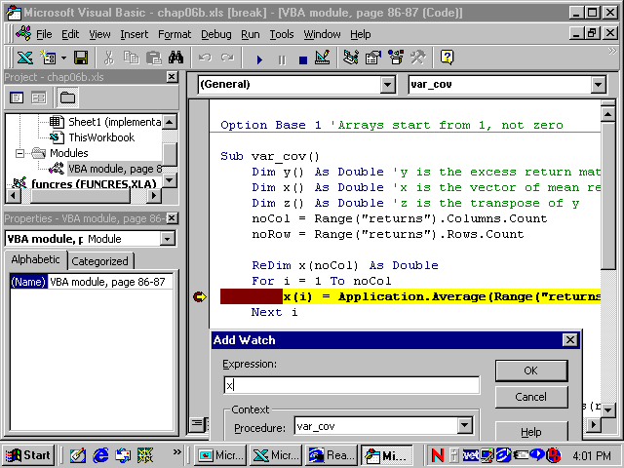
Adding a watch
If you want to see a variable value whilst the macro is running.

Slide 13
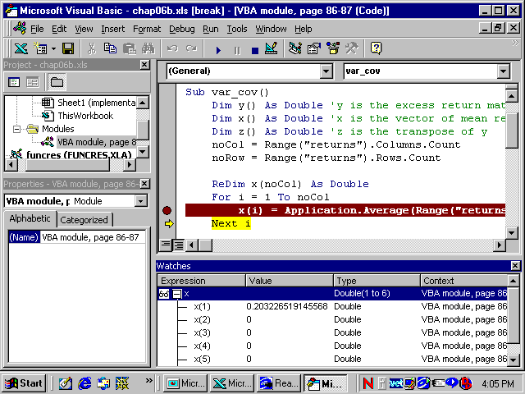
What is the value of x(1)?

Slide 14
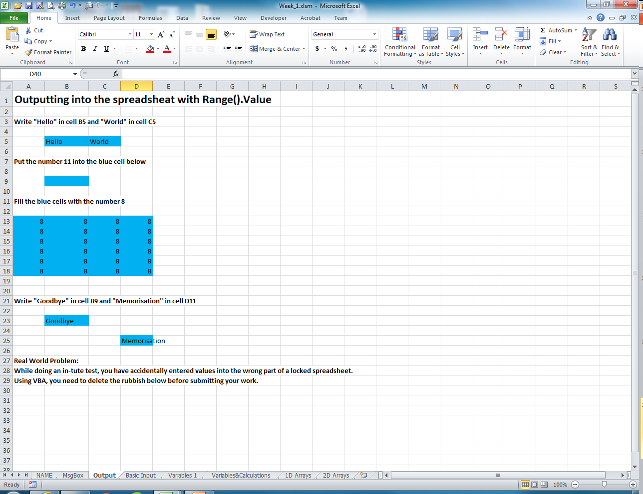
Week 1 Output using Range().Value

Slide 15
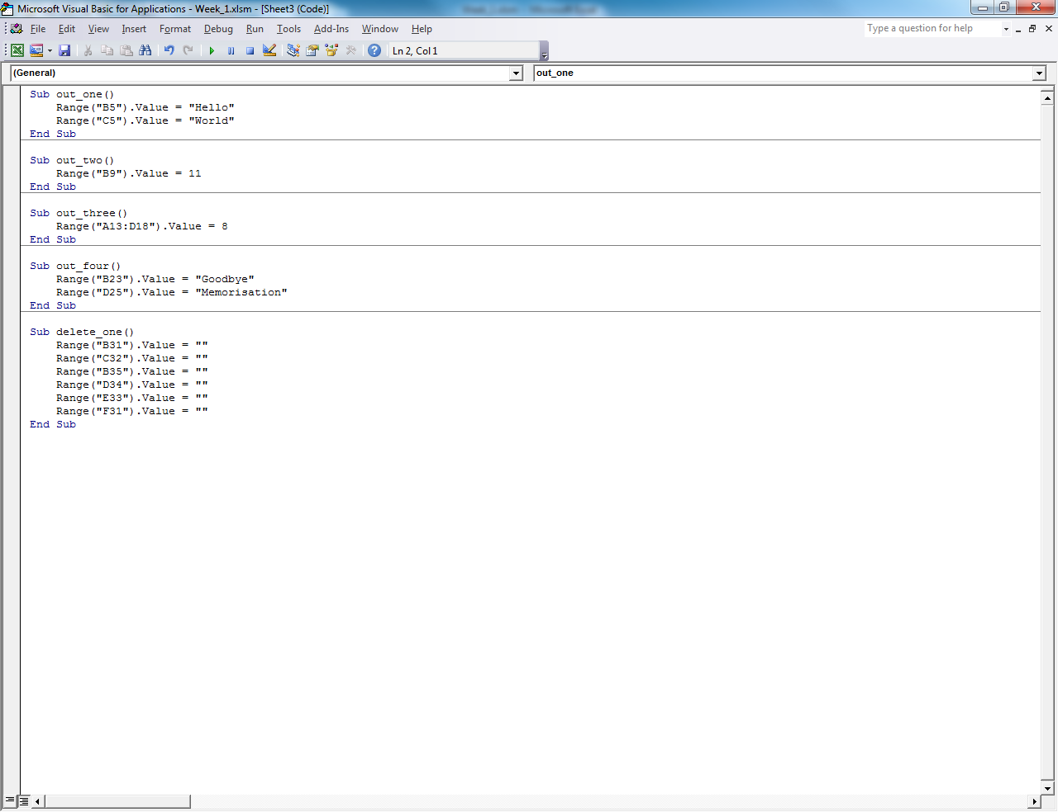
Week 1 Output Solution using VBA Range().Value

Slide 16
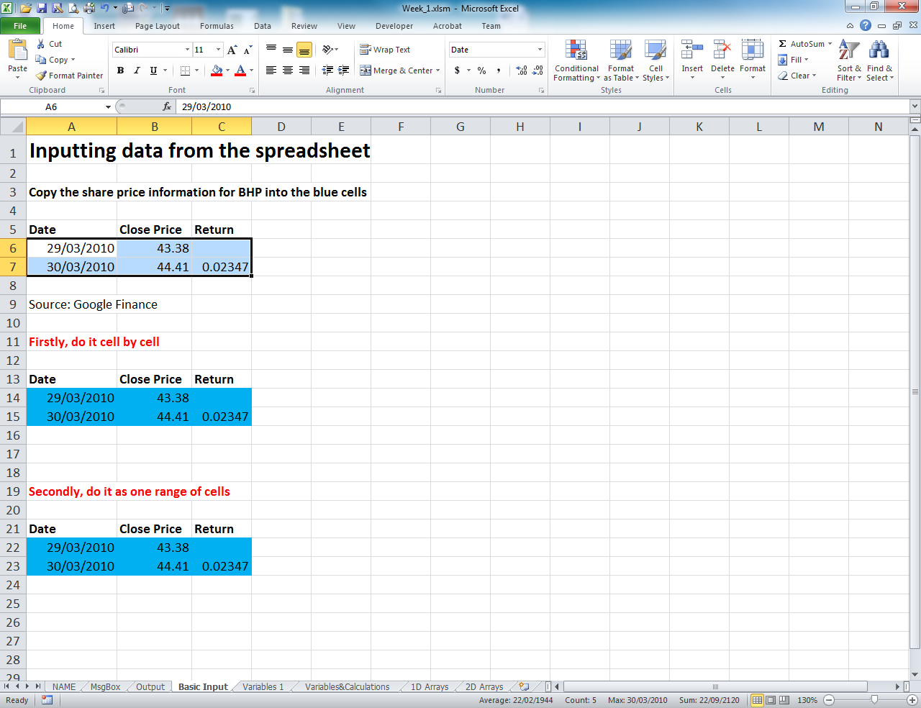
Week 1 Basic Input using Range().Value

Slide 17
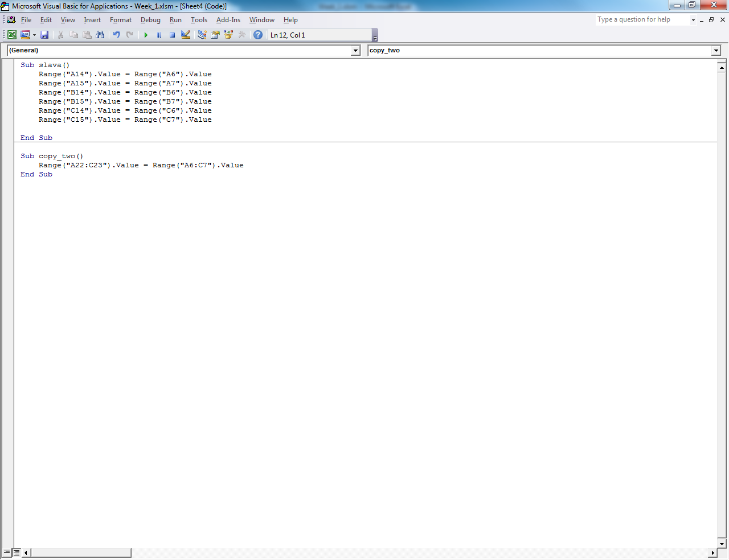
Week 1 Output Solution using VBA Range().Value

Slide 18
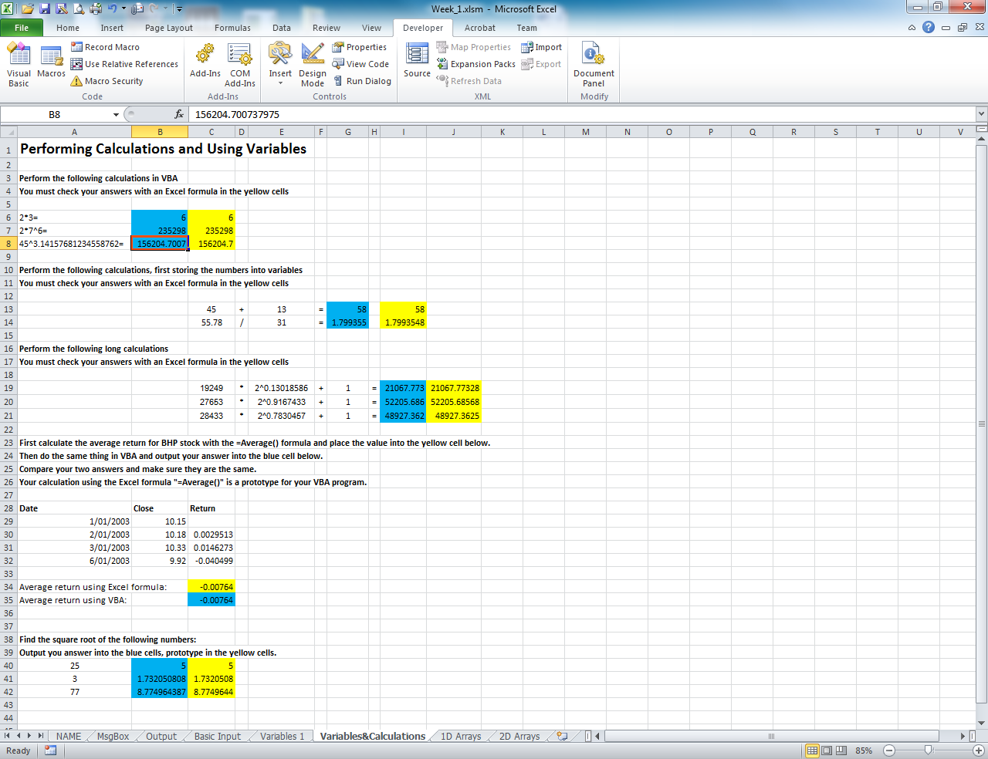
Week 1 Performing Calculations using Variables

Slide 19
Week 1 Performing Calculations using Variables VBA solution

Slide 20
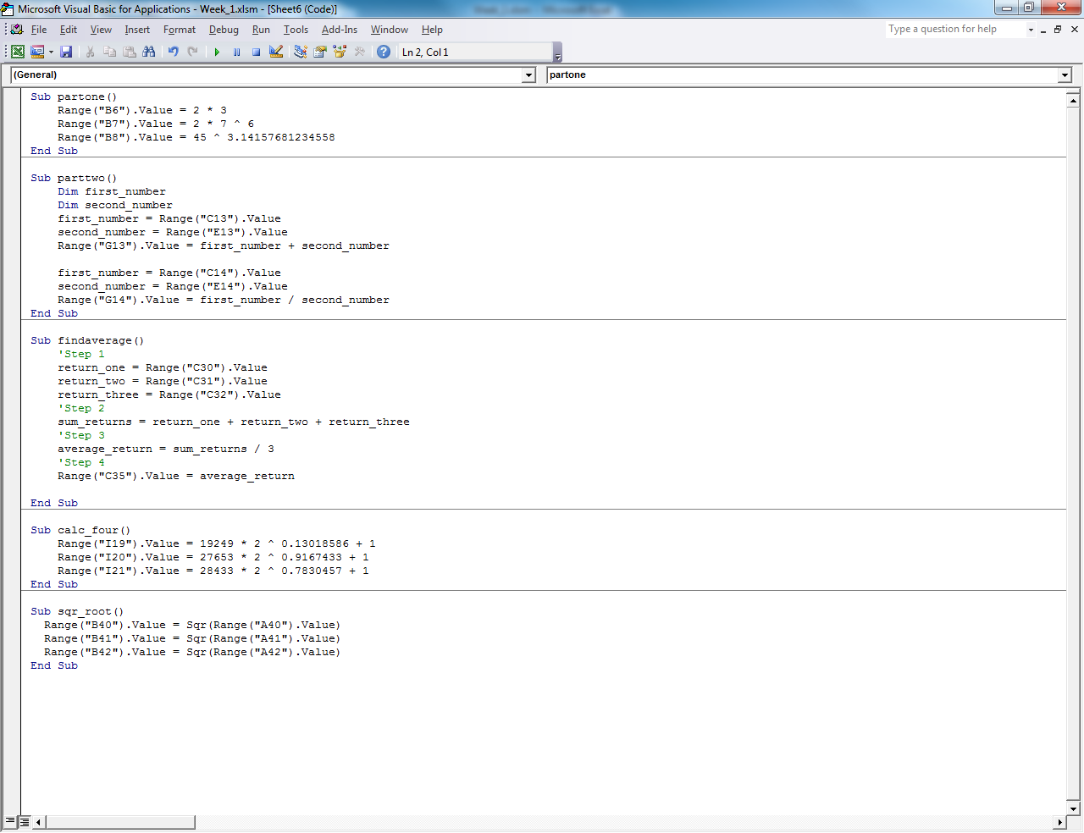
Week 1 Performing Calculations using Variables VBA solution

Slide 21
Dim, Data Types
What is a variable in VBA?
What are Data Types?
Integer
String
Double

Slide 22
Arrays in VBA

Slide 23
Arrays in VBA

Slide 24
FLUX POLLS
The Lecturer will now provide additional slides on FLUX polls.

Slide 25
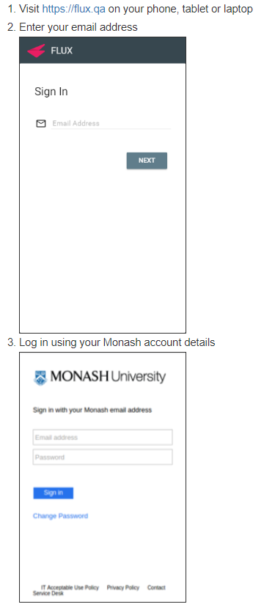
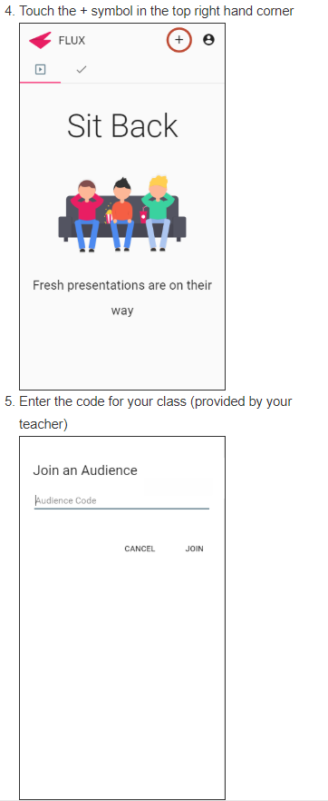
How to Login to FLUX

Slide 26

Flux Class Code for BFC3540

Slide 27
Download Week 1 VBA (in Week 1 Tab on Moodle for BFC3540)
Go to Moodle and download the homework spreadsheet now, if you haven’t already.

Slide 28
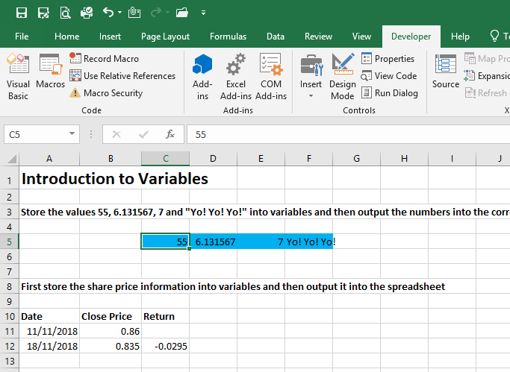
Question 1 Spreadsheet VBA 1: Flux

Slide 29
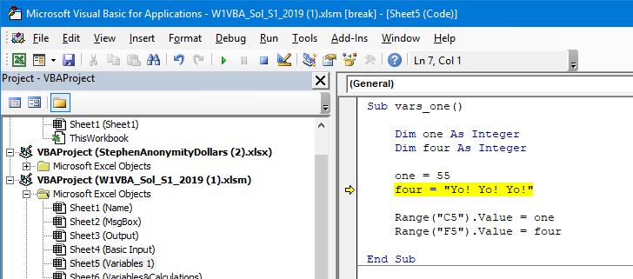
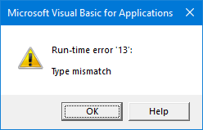
Q1: What’s causing the error?

Slide 30
Submit your response
What did everyone think is the correct answers. Lets have a look at the Flux histogram of responses.
You will have 5 min to discuss your initial response with the people around you in the lecture.
You will have an opportunity to resubmit your initial response now.

Slide 31
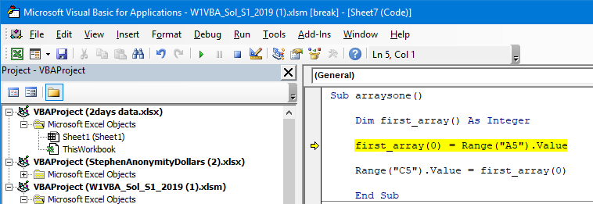
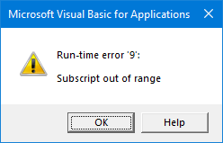
Q2: What’s causing the error?

Slide 32
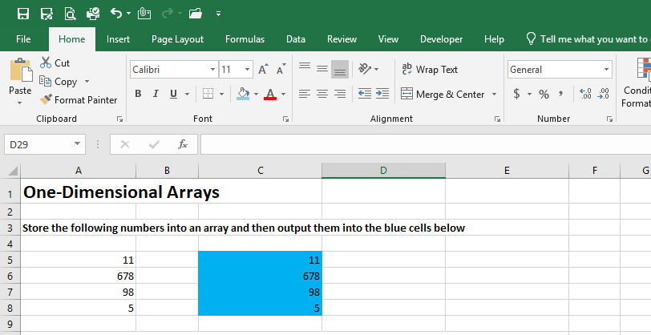
Question 2 Spreadsheet VBA 1: Flux

Slide 33
Submit your response
What did everyone think is the correct answers. Lets have a look at the Flux histogram of responses.
You will have 5 min to discuss your initial response with the people around you in the lecture.
You will have an opportunity to resubmit your initial response now.

Slide 34
Conclusions
Open and get used to the VBA environment.
Understand how to use the VBA debugger.
Start Looking at the VBA movies in the first tute, but complete the exercises at home.
Use your VBA group leader for help, support and direction. Communicate with them often.
Submit the VBA spreadsheet each week (unless you are a group leader).

